Slide 1
Final Project Presentation – Octavio Suarez Munist
Online pre-course survey of college ~800 Chemistry Students in several institutions
Questions of unknown origin
Possible post-course survey
Determine appropriateness of questionnaires and predictive potential
Visual representations
Descriptives
Correlations
Factor Analysis
Regressions

Slide 2
Final Project Presentation – Octavio Suarez Munist
Q10_1 | To what degree do you agree with / the following statements?--Good grades are important to me
Q10_2 | To what degree do you agree with / the following statements?--I am well-prepared before I come to class
Q10_3 | To what degree do you agree with / the following statements?--I come well rested to class
Q10_4 | To what degree do you agree with / the following statements?--I study for exams
Q10_5 | To what degree do you agree with / the following statements?--I attend class regularly
Q10_6 | To what degree do you agree with / the following statements?--I am confident in my ability to succeed in this course.
Q10_7 | To what degree do you agree with / the following statements?--I pay attention in class
Q10_8 | To what degree do you agree with / the following statements?--I know I will graduate from college
Q10_9 | To what degree do you agree with / the following statements?--I can think of many ways to get good grades
Q10_10 | To what degree do you agree with / the following statements?--I energetically pursue my goals
Q10_11 | To what degree do you agree with / the following statements?--I can find lots of ways around any problem
Q10_12 | To what degree do you agree with / the following statements?--Time flies when I study
Q10_13 | To what degree do you agree with / the following statements?--I am proud of my studies
Q10_14 | To what degree do you agree with / the following statements?--When I study I feel good
Q10_15 | To what degree do you agree with / the following statements?--My studies mean something to me
V8 | StartDate
V9 | EndDate
V10 | Finished
Q1 | Chemistry Study / Spring 2014 - PRESURVEY
Q2 | Please Select your school from the list below:
Q3 | Previous to this semester, how many semesters have you attended classes / at this university?
Q4 | What was your GPA (Grade Point Average) your last semester in / college?
Q5 | What grade do you expect to obtain in this class?
Q6 | How many credit hours are you taking this semester?
Q29 | Please list the other courses you are taking this / semester.
Q7 | What is your intended degree?
Q8 | Why did you choose to take this course?
Q9 | Please rate your overall level of interest in the subject matter of this / course.
Q10_1 | To what degree do you agree with / the following statements?--Good grades are important to me
Q10_2 | To what degree do you agree with / the following statements?--I am well-prepared before I come to class
Q10_3 | To what degree do you agree with / the following statements?--I come well rested to class
Q10_4 | To what degree do you agree with / the following statements?--I study for exams
Q10_5 | To what degree do you agree with / the following statements?--I attend class regularly
Q10_6 | To what degree do you agree with / the following statements?--I am confident in my ability to succeed in this course.
Q10_7 | To what degree do you agree with / the following statements?--I pay attention in class
Q10_8 | To what degree do you agree with / the following statements?--I know I will graduate from college
Q10_9 | To what degree do you agree with / the following statements?--I can think of many ways to get good grades
Q10_10 | To what degree do you agree with / the following statements?--I energetically pursue my goals
Q10_11 | To what degree do you agree with / the following statements?--I can find lots of ways around any problem
Q10_12 | To what degree do you agree with / the following statements?--Time flies when I study
Q10_13 | To what degree do you agree with / the following statements?--I am proud of my studies
Q10_14 | To what degree do you agree with / the following statements?--When I study I feel good
Q10_15 | To what degree do you agree with / the following statements?--My studies mean something to me
Q11 | How much time, in hours, do you expect to spend on homework and studying / outside of class per week?
Q12 | How many hours per week do you expect to work at a job this semester?
Q13 | What is your gender?
Q14 | What is your race/ethnicity? Please mark the one box that describes the race/ethnicity category with...
Q15 | Is English your first language?
Q16 | What is your age?
Q17 | What is your intended major?
Q18_1 | Do / you have one or more of the following disabilities or medical conditions that / affects your abilit...-None
Q18_2 | Do / you have one or more of the following disabilities or medical conditions that / affects your abilit...-Attention deficit hyperactivity disorder (ADHD)
Q18_3 | Do / you have one or more of the following disabilities or medical conditions that / affects your abilit...-Autism spectrum/Asperger’s Syndrome
Q18_4 | Do / you have one or more of the following disabilities or medical conditions that / affects your abilit...-Chronic illness (e.g., cancer, diabetes, autoimmune disorder)
Q18_5 | Do / you have one or more of the following disabilities or medical conditions that / affects your abilit...-Learning disability (e.g., dyslexia)
Q18_6 | Do / you have one or more of the following disabilities or medical conditions that / affects your abilit...-Physical disability (e.g., sight, hearing)
Q18_7 | Do / you have one or more of the following disabilities or medical conditions that / affects your abilit...-Psychological disorder (e.g., depression, bipolar disorder)
Q18_8 | Do / you have one or more of the following disabilities or medical conditions that / affects your abilit...-Other
Q19_1 | Have you ever taken General Chemistry before? (Please select all that apply)-No, this is the first time
Q19_2 | Have you ever taken General Chemistry before? (Please select all that apply)-Yes, in High School
Q19_3 | Have you ever taken General Chemistry before? (Please select all that apply)-Yes, in college and received the following grade (A-F or Withdrew or Incomplete)
Q19_3_TEXT | Have you ever taken General Chemistry before? (Please select all that apply)-Yes, in college and received the following grade (A-F or Withdrew or Incomplete)-TEXT
Q20_1 | To what degree do you agree with / the following statements?--I regularly use a computer or iPad or similar device when in class
Q20_2 | To what degree do you agree with / the following statements?--Using online materials helps me in my studies
Q20_3 | To what degree do you agree with / the following statements?--I have used online learning materials regularly in high school and college
Q21 | Are you using or have you used an online homework system in other / courses ? If yes, please list these.
Q22 | How do you think the use of technology will affect your level of / interest in this course?
Q23 | How do you think the use of technology will affect your level of / engagement in this course?
Q24 | Compared to your peers, how would you rate your ability with / computers?

Slide 3
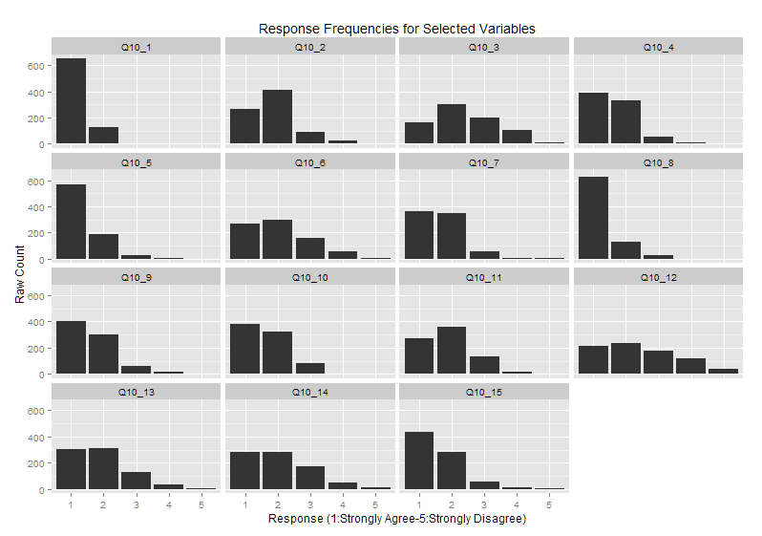
Final Project Presentation – Octavio Suarez Munist

Slide 4
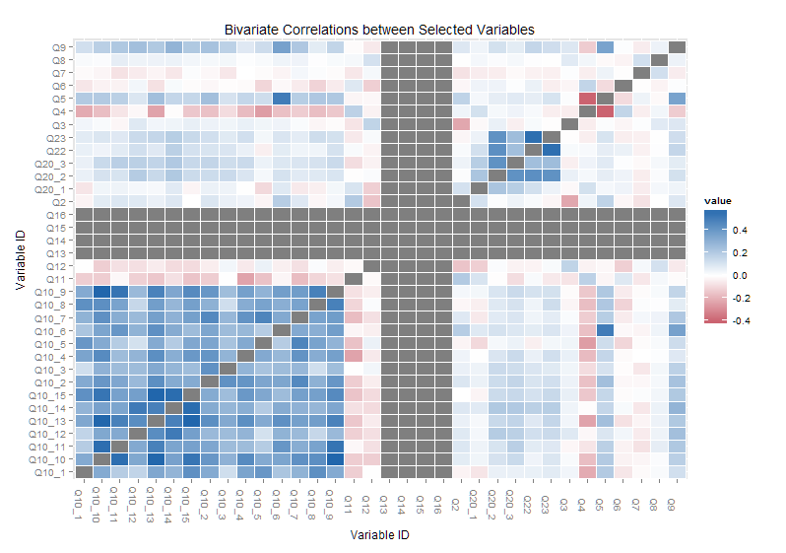
Final Project Presentation – Octavio Suarez Munist

Slide 5
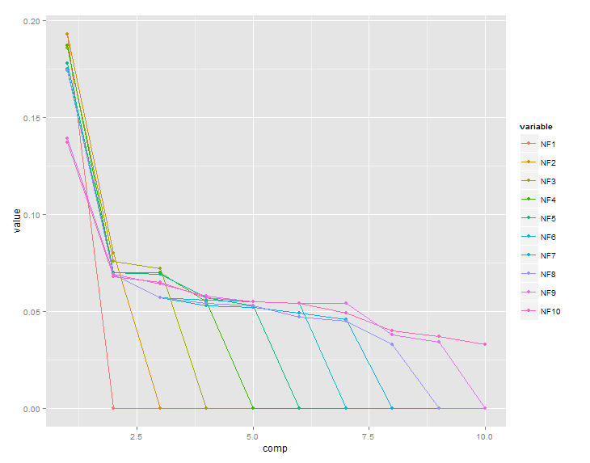
Final Project Presentation – Octavio Suarez Munist

Slide 6
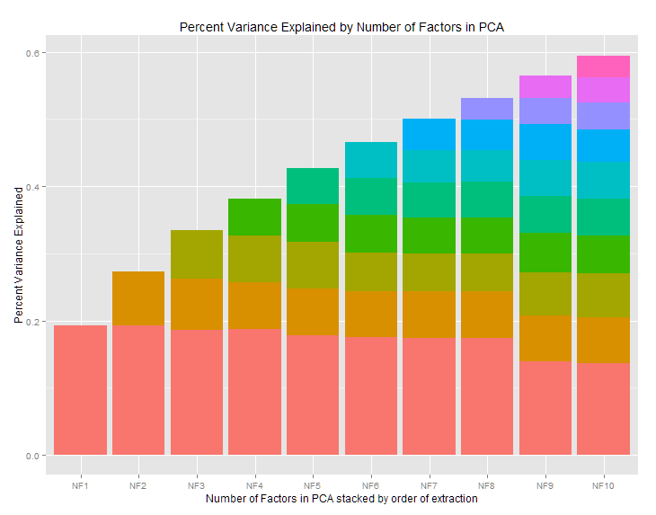
Final Project Presentation – Octavio Suarez Munist

